Slide 1
Faith In Action’s Accompaniment Project Training
April 25th, 2017

Slide 2
Faith In Action’s Accompaniment Project
Faith In Action’s Accompaniment Project is a community led and volunteer-based solidarity group dedicated to defending safe spaces for migrants and other targeted communities in San Mateo and San Francisco.
The Accompaniment Project connects interfaith volunteers and other allies with members of our communities who have to report to ICE, appear in immigration court, or request accompaniment for other civil or criminal encounters. We see accompaniment as a values based political response to the violence inflicted on immigrant and refugee communities by decades of oppressive policies.
Notes:
Frame within work that Sanctuary DMV is doing
Launch of sanctuary congregations that morning, part of bigger effort to protect immigrant communities in the DMV area
Opportunities to plug into other work – rapid response, KYR trainings
Say that we are not an organization, we are a volunteer group
*Explain why we are using the term “compas” to describe immigrants we are accompanying:
“Our “compas” – compañeros and compañeras, our partners – are our equals in the struggle for justice. Throughout this manual, we refer to migrants and refugees we are accompanying through encounters with law enforcement as “compas” in an effort to recognize their dignity, power, and centrality to the movement.”

Slide 3
Context of US Immigration System

Slide 4
Anyone born in the US is a US citizen, even if their parents are undocumented.
Notes:
TRUE
This comes from the 14th Amendment: “All persons born or naturalized in the United States, and subject to the jurisdiction thereof, are citizens of the United States and of the state wherein they reside. No state shall make or enforce any law which shall abridge the privileges or immunities of citizens of the United States; nor shall any state deprive any person of life, liberty, or property, without due process of law; nor deny to any person within its jurisdiction the equal protection of the laws.”
There are a few ways to become a US citizen:
BY LAND: Born in the U.S.
BY BLOOD: Born outside the U.S. to a U.S. citizen parent
BY DERIVATION: Born outside the U.S. and one or both parents become U.S. citizens while you are under 18 and an LPR
BY NATURALIZATION: Born outside the U.S., you become an LPR for 5 years (or 3 if married to a U.S. citizen), meet other requirements, and file an application
Naturalization requirements:
Be at least 18 years old
Have a green card (LPR status) for:
5 years
OR 3 years if married to and living with U.S. citizen
Meet requirements for amount of time spent inside U.S.
No evidence of abandoning green card
Speak, read, write basic English (some waivers)
Answer questions about U.S. civics
Show attachment to U.S., take meaningful oath
Have “good moral character”
Pay $680 naturalization fee (unless qualify for waiver)

Slide 5
There are ways for unauthorized immigrants to “get right with the law.”
Notes:
FALSE (some exceptions)
While there may be options for folks with immediate relatives who are US citizens or LPRs, and there are a limited number of employment visas and humanitarian visas available, for most unauthorized immigrants, there is currently no way to adjust status.
“Many people who qualify for green cards based on their relationships to U.S. citizens or lawful permanent resident relatives are caught in a Catch-22—under current law they must leave the United States to apply for their green card abroad, but as soon as they depart, they are immediately barred from re-entering the country for a period of time [3 or 10 years, depending on how long they lived in the US without status]. In other words, because of the punitive effect of our immigration laws, immigrants who have a chance to legalize their status may not be able to do so.”
*From the American Immigration Council
Paths to LPR status:
Family: certain close relatives of U.S. citizens, LPRs
Includes certain survivors of domestic violence
Employment-based
Asylum, refugee status
U and T status (crime, trafficking victims)
Diversity lottery (“green card lottery”)
Miscellaneous
NO paths to LPR status:
Tourists
Students
Temporary Protected Status (TPS)
Deferred Action for Childhood Arrivals (DACA), expanded DACA, DAPA
Undocumented people
Employment visa, if not sponsored by employer

Slide 6
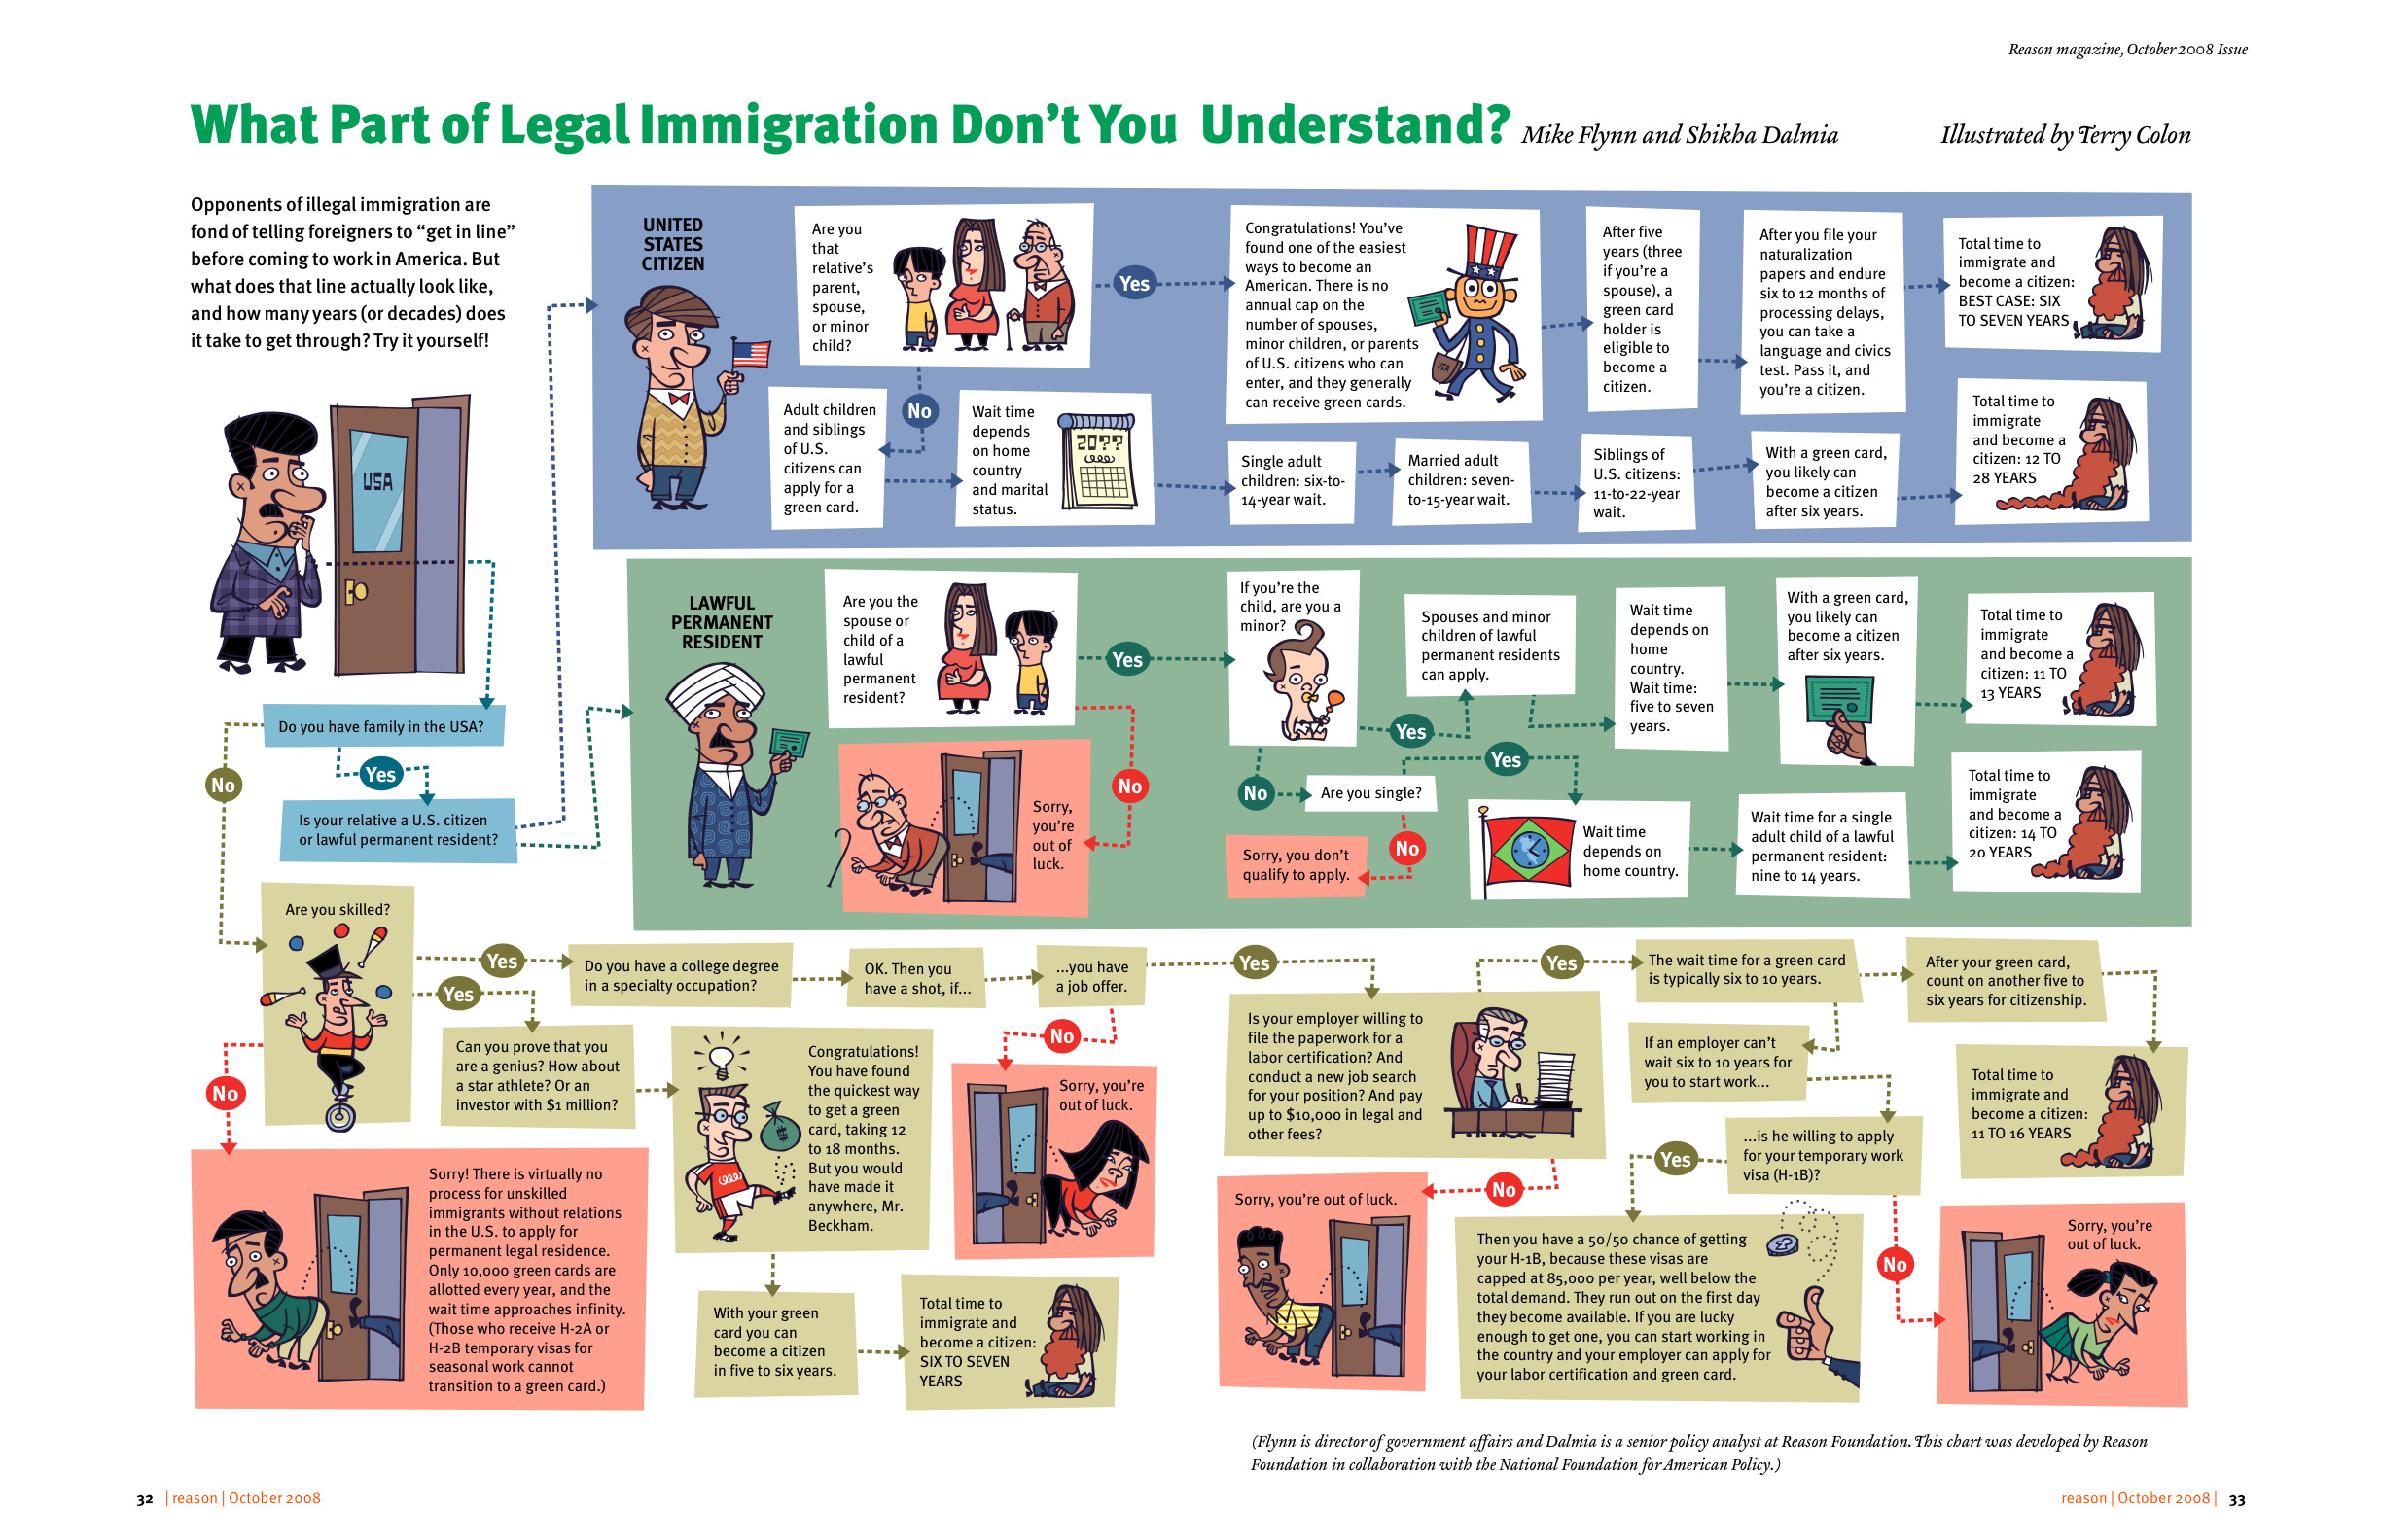
Notes:
http://reason.com/blog/2013/01/30/reason-replay-what-part-of-legal-immigra

Slide 7
If you are a lawful permanent resident (greencard holder), you cannot be deported.
Notes:
FALSE – LPRs with certain criminal convictions or who have lived outside the United States for a long period of time may be subject to deportation.

Slide 8
If you have a child in the US, you cannot be deported.
Notes:
FALSE

Slide 9
A person may be deported from the US without having a hearing before an immigration judge.
Notes:
TRUE
For trainers’ reference:
Congress established streamlined deportation procedures that allow the government to deport certain noncitizens from the US without a hearing before an immigration judge. Two of these procedures, “expedited removal” (INA sec 235(b)) and “reinstatement of removal” allow immigration officers to serve as both prosecutor and judge. These rapid deportation decisions often fail to take into account many critical factors, including whether the individual is eligible to apply for lawful status in the US, whether he or she has long-standing ties here, or whether he or she has US citizen family members.
Expedited removal: formally deporting noncitizens who don’t have proper entry documents and who are seeking to enter at POE, or who are found within 100 miles of the border. Applies only if immigration officer determines that an individual committed fraud or misrepresented material fact for the purposes of seeking entry into the US; falsely claimed USC; or is not in possession of a valid visa or other required doc.
Reinstatement of removal applies to noncitizens who return illegally to the US after having been previously deported (even if deported in absentia).

Slide 10
Immigrants in deportation proceedings have a right to legal counsel.
Notes:
FALSE

Slide 11
ICE is not allowed to conduct raids on churches, schools, or health centers.
Notes:
FALSE – 2011 safe zones memo is just a memo and has consistently been violated. However, sensitive locations are still protected by the fourth amendment’s prohibition of unreasonable searches and seizures can require a warrant and/or permission of the director or designated person for law enforcement to enter.

Slide 12
Local police and local jails can decide whether or how they will use local resources to enforce immigration law.
Notes:
TRUE
“At their core, “sanctuary” policies are decisions by state and local governments about state and local priorities, particularly law enforcement priorities. Many of these policies offer the protections of equal treatment, privacy and confidentiality to community members. Some limit affirmatively sharing an individual’s immigration status, release date, or other immigration information except as required by law; others direct local law enforcement to refrain from asking victims and witnesses about immigration status; still others prohibit local authorities from investigating, arresting, or detaining individuals on immigration-related grounds. Importantly, “sanctuary” policies do not prevent federal immigration authorities from entering local jurisdictions and detaining, arresting, or deporting immigrants using federal resources and officers. […]
The plain text of 8 U.S.C. § 1373 covers only information about citizenship or immigration status—not other information—and does not require state and local actors to collect any information regarding immigration status. 8 U.S.C. § 1373 only prohibits restrictions on the sharing of information that is collected. […] Further, nothing in 8 U.S.C. § 1373 requires jurisdictions to prolong the detention of individuals otherwise entitled to release to comply with an immigration detainer. Thus, “sanctuary” policies that direct local law enforcement agencies to refrain from collecting immigration information or to decline detainers requesting prolonged detention requests do not violate 8 U.S.C. § 1373.”
From the Immigrant Legal Resource Center

Slide 13
About two million individuals were deported under President Obama.
Notes:
FALSE – 3 million

Slide 14
During the Accompaniment: What to Expect

Slide 15
Accompaniment - Acompañamiento
The root of acompañamiento is compañero or friend (Goizueta, 1995). It draws from the Latin ad cum panis, to break bread with one another. Accompaniment often, though not exclusively, occurs in communities that are struggling with various collective traumas, including poverty, violence, forced migration, racism, and environmental assault. While accompaniment of one by another in times of difficulty crosses all cultural and economic groups.

Slide 16
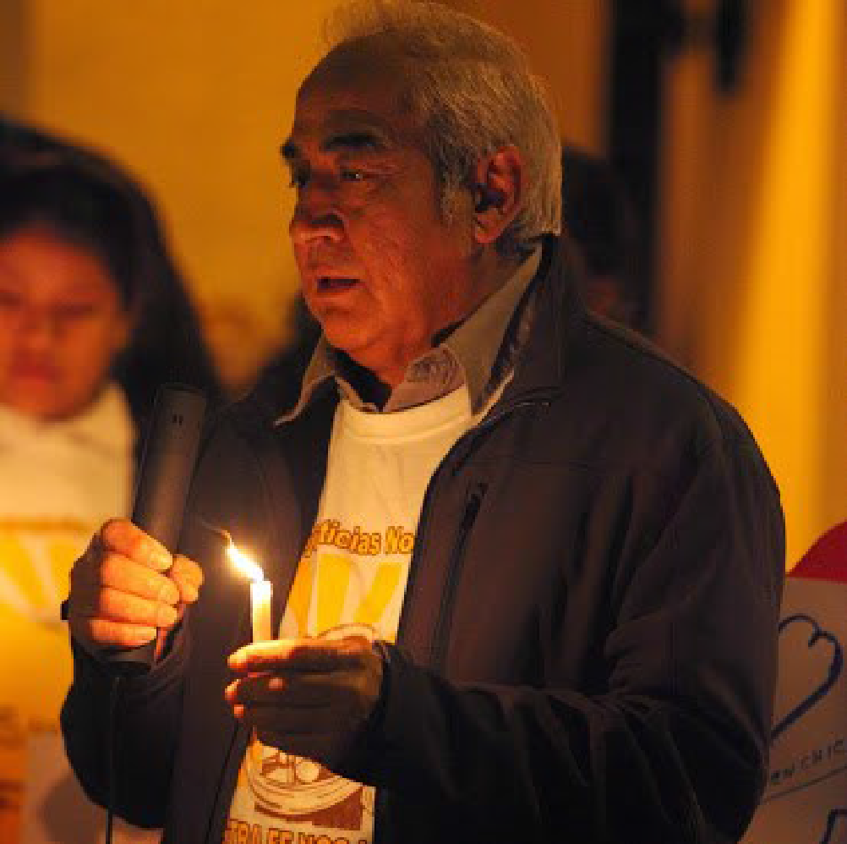
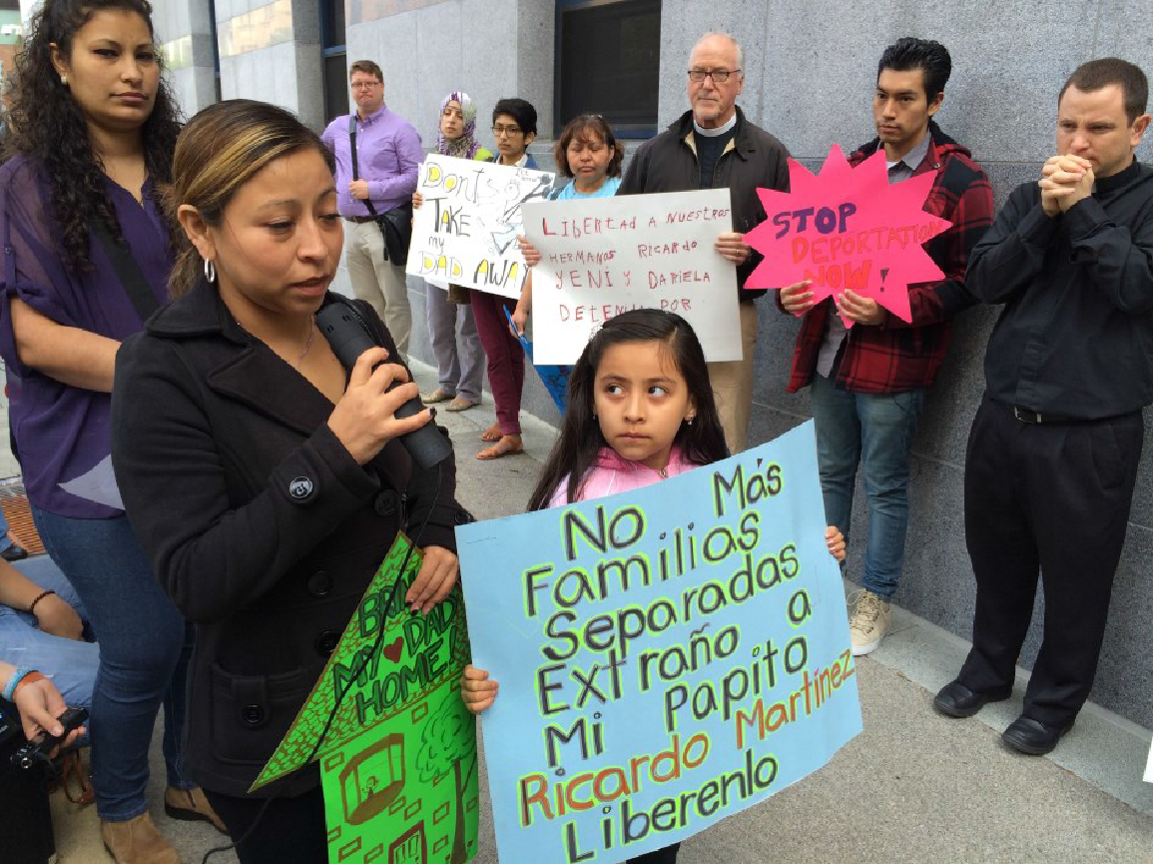
Our Experience:

Slide 17
Accompaniment – Acompañamiento
Take Steps to Shine the Light on the Moral Crisis and Contradictions
Non-violent resistance: Sanctuary
Public campaign (if nessesary): vigils, online petitions, actions, Press events, etc.
Walk together in public:
Present them to the congregations, go to their court hearings, check ins, etc
Understand the legal case: Talk with the attorney (or find them an attorney)
Relationship: ID families who need and want accompaniment, then take time to assess the families’ needs

Slide 18
Why Accompaniment?
Why do people have to check in periodically with ICE?
How does accompaniment help?
In which settings will Accompaniment volunteers provide accompaniment?
ICE offices (San Francisco)
EOIR and Federal Asylum Hearings – Immigration Courts (San Francisco)
ISAP program offices (San Francisco)
District courts (by request)

Slide 19
Expectations for Volunteers
Maintain a respectful relationship at all times
No judgments should be placed on yours or your “compa’s” history, appearance, or situation
Do not give legal advice, whether solicited or not
If your “compa” has a lawyer with her, respect the need for private conversation
You are not a social worker, job counselor, ESL teacher, and you are not expected to lend or give money, etc.

Slide 20
Expectations for Volunteers
Information about your compa is confidential unless she has decided to publicly escalate her case
Do not ask for information that she is reluctant to give
Team lead is responsible for following Faith In Action’s protocol in the event that your compa is detained
Use good judgment; we can’t anticipate every situation that might arise
You are always welcome and encouraged to attend Faith In Action meetings and events

Slide 21
Expectations for “Compas”
Maintain a respectful relationship at all times
No judgments should be placed on yours or your acompañante’s history, appearance, or situation
The Accompaniment Project and your acompañante do not provide legal advice, counsel, or representation, and we cannot guarantee a positive outcome for your case
Volunteers are not job counselors, ESL teachers or social workers, and are not expected to lend or give money, etc.

Slide 22
Expectations for Compas
You do not need to share any information about yourself or your case with your acompañante. S/he is here to be with you through your court/ICE encounter.
Please fill out the emergency contact sheet so that your acompañante has essential information in case you are arrested
Information on this sheet will be kept confidential
You will fill out the sheet and give it to volunteers to hold onto while you are in your check-in
You will get the sheet back after the check-in is over
If you would like to share your story or any feedback about your experience with accompaniment, you are invited to do so via the Compa Feedback Form
You are always welcome and encouraged to attend Faith In Action meetings and events

Slide 23
ICE Check-In
They happen at 630 Sansome in the 5th Floor.
An ICE officer will call the name of your compa.
You compa should hand her personal belongings to you to hold in case she is detained. She should go speak with the ICE officer with only her ID and her ICE check-in sheet in her hands.
An ICE officer will check her ID and sign her check-in sheet, giving her a future reporting date.
She may be taken to a private room with the ICE officer. You can ask to accompany your compa and the ICE officer if she wants accompaniment, but do not be surprised if you are not allowed to be present during this aspect of the check-in.

Slide 24
Immigration Court Hearing
Your compa will be called to the front of the court by the last three digits of her A number and/or last name. The A number is the 9 digit number associated with your compa’s immigration case.
Your compa will be asked to sit at the counsel table on the right side when looking at the Immigration Judge and will put on headphones to receive simultaneous language interpretation.
The Judge will ask your compa several questions and she will answer to the best of her ability. The Judge will then give your compa a date to return to court.

Slide 25
ISAP Check-In (Intensive Supervision Appearance Program)
BI Incorporated
Your compa will go into a waiting room in a corporate office setting and will hand her ID and check-in card to the receptionist
You will be asked to leave – reassure your compa that you will be waiting outside
Your compa will wait – possible for several hours – and meet with her BI/ISAP case manager, who will give her a follow-up date

Slide 26
Reminders
Bring a state or federally issued picture ID
Bring your cell phone and a charger
Turn off your cell phone in a court room; silence your cell phone in any ICE office
There is no reason to dress up; looking clean and neat is enough
Never discuss your compa’s case in the immigration offices
Your compa’s full name, identity, where she lives, and any details she may share with you about her case are confidential
If you bring food, you may be asked to throw it away

Slide 27
Trauma-Informed Care During Accompaniment

Slide 28
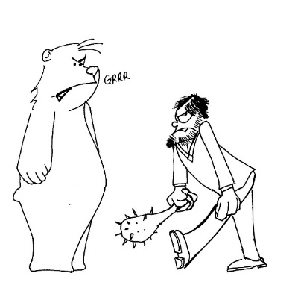
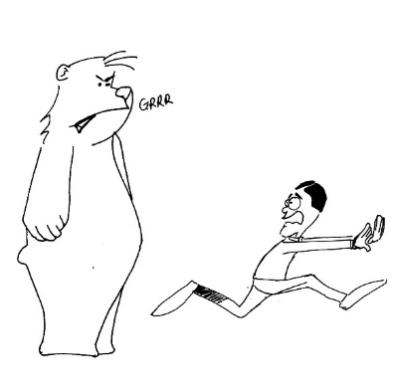
Trauma Responses
Fight
Flight
Freeze
6

Slide 29
Emotional First Aid
Do’s
Don’ts
Promote Safety
Meet basic needs
Provide repeated, simple and accurate information
Promote Calm
Promote Connectedness
Promote Self-Efficacy
Promote Hope
Have a list of services on hand that people might need
Force people to share their stories
Give simple reassurances
Tell people what you think they should be feeling
Tell people why you think that this has happened (make predictions about the future without accurate information)
Make Promises that may not be kept

Slide 30
Grounding Helping People through Flashbacks
Remind them that is a COMMON trauma reaction
Let their body discharge energy (go for a walk, cry, shake)
Ground them in the present by noting what you see hear, smell- help them bring awareness to what is going on in their body and what time and date it is
Pray, mediate, journal - bring coloring books, stress balls to squeeze
Seek help if they persist over a month

Slide 31
Compassion fatigue and Self-Care
Don’t burn out!!
Take your emotional temperature every day-understand your body’s signals for stress
Pay attention to life/work balance
Remember you have trauma work to do also
Establish a support system
Be honest about what you can realistically do
Eat well and exercise (get rid of trauma energy)

Slide 32
Emotional Safety Plans
Put on your own oxygen mask first!
Have tools and awareness before something happens

Slide 33
Outcomes of the Accompaniment

Slide 34
What to do if your compa is detained?
This is among the most important parts of the Accompaniment Project.
Call the number(s) listed on the CONFIDENTIAL emergency contact list
Contact Faith In Action
Try to find out which detention center your compa is being sent to
Try to find out if deportation is imminent by asking the ICE officers
Speak to a supervisor if necessary
Ensure that whatever personal property is returned to the family
With the permission of the family, a call to action and activate a plan to try to stop the deportation

Slide 35
Two Inter-Related Goals
Build an alternative narrative of immigrants in our community and counter the narrative around enforcement and criminalization.
Agitate and create tension with public officials by lifting up the humanizing stories of immigrants, the damage of current federal policies and the need for local protections.

Slide 36
Role of Team
Implement a structure to identify cases
Train organizers, leaders and clergy on how to identify cases
Structure a plan to defend against deportation
Act as resource and guide through the process

Slide 37
What will happen when a case is identified?
Plan of Action Developed:
Direct Calls to MOC
Detailed Letter of Support
Targeted Phone Calls by Congregation Members and Supporters
Direct Action: Picketing and Vigils
Contacting of Media/ Press Conference
Involvement of Supportive MOC
Direct Calls to Local ICE and National Headquarters
Online Petitions
Social Media and Videos of Family

Slide 38
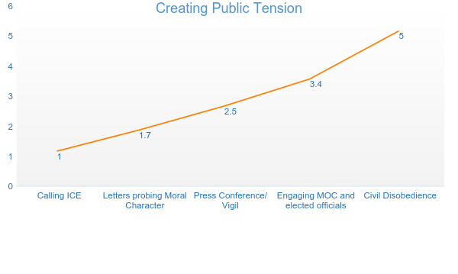
Public Tension and highlighting the moral dilemma

Slide 39
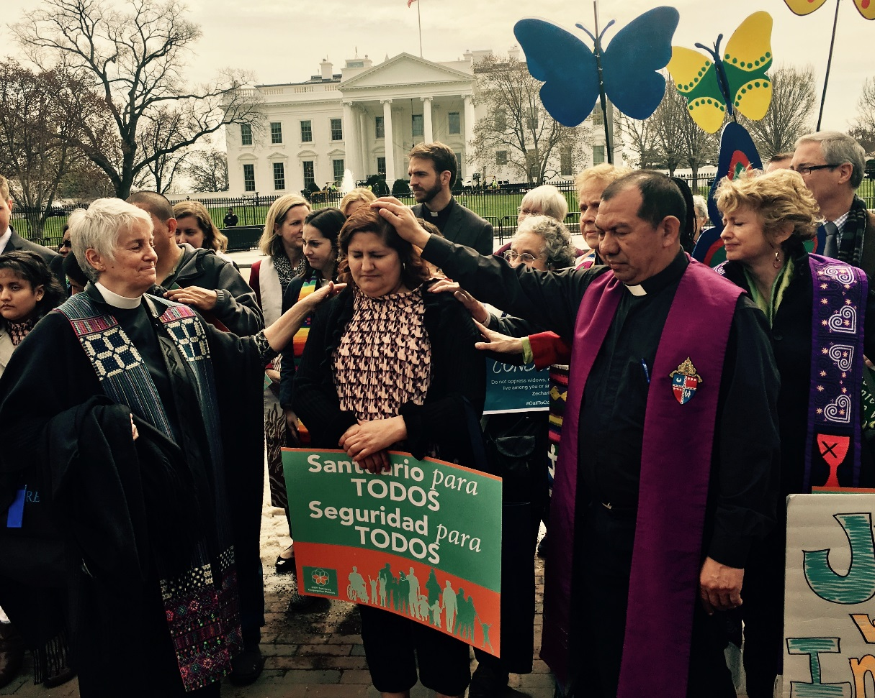
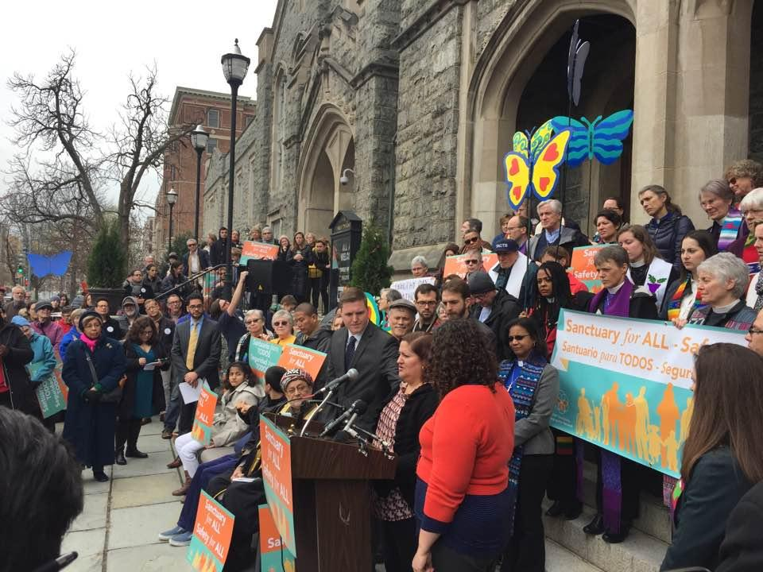

Slide 40
Volunteer Matching, Follow-Up, & Logistics

Slide 41
How to Volunteer for an Accompaniment
The Faith In Action Accompaniment Organizing Committee sends a notification to our accompanier email list when accompaniment is needed – date, time, location
Collect volunteers by email
The Accompaniment Organizing Committee assembles team of volunteers, connects them to each other
The Accompaniment Organizing Committee shares more information with the team lead for the specific day of accompaniment
Leader reaches out to “compa” to confirm logistics and coordinates with rest of accompaniment team

Slide 42
After Your Accompaniment
Team fills out a volunteer record sheet with basic information about how the accompaniment went
Leader sends completed sheet to Faith In Action’s Accompaniment Project and debriefs by phone if necessary
If next check-in or appointment date is known, team members let Faith In Action’s Accompaniment Project know if they can accompany this individual again at their next appointment
Always keep sensitive information about your compa confidential and do not share online, on social media, or in any public forum.

Slide 43
QUESTIONS?

